Slide 1
Interpreting Machine Learning Models
Pointwise Learning to Rank Example

Slide 2
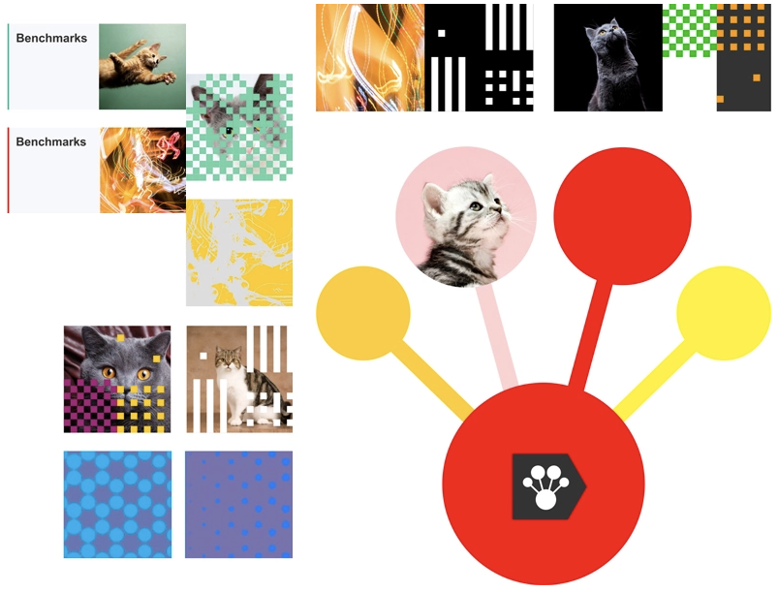
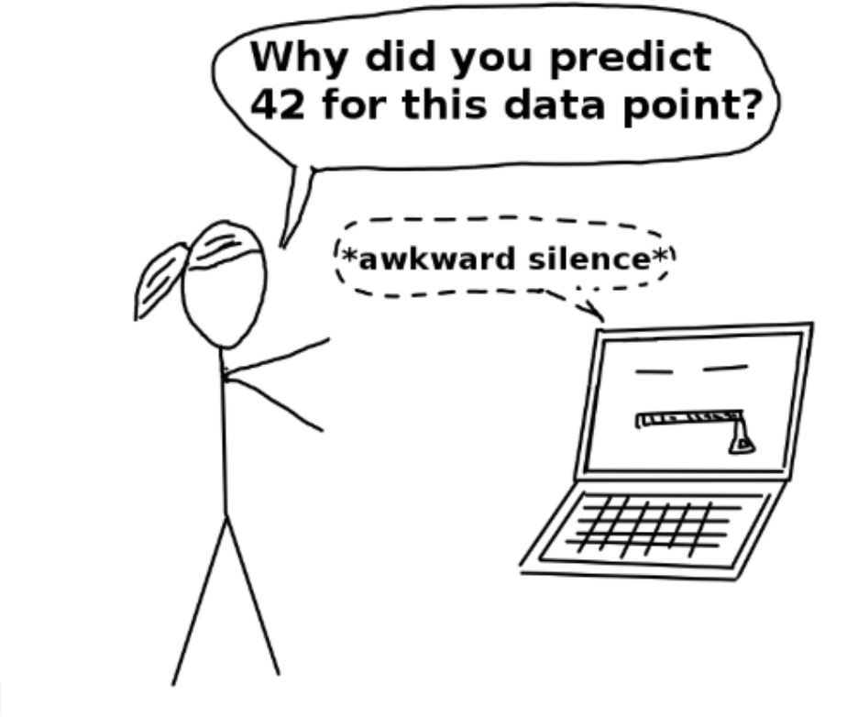
What sparks joy for me

Slide 3
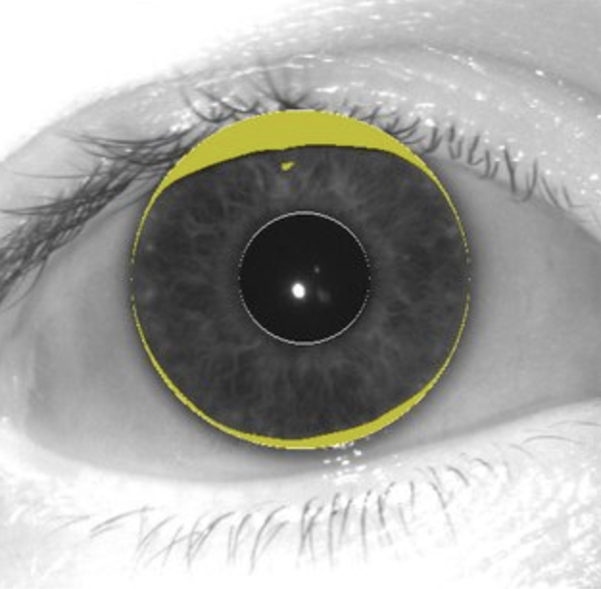
Why machine learning interpretability matters
Having better interpretability will lead to higher adoption
Building interpretable models will help us reduce machine learning bias
Regulations - GDPR: “Fully automated decisions must be explainable”

Slide 4
Machine learning interpretability methods

Slide 5
Classification of machine learning interpretability methods
Model specific methods (learned weights) – limited to a specific model
Model agnostic methods – separating the explanations from the machine learning model
Local - does the interpretation method explain an individual prediction
Global - does the interpretation method explain the entire model behavior

Slide 6
List of machine learning interpretability methods
What we are going to cover
Model specific feature importance
Shapley Values
Surrogate models
Other methods available
Permutation importance
Partial dependence
Accumulated local effects

Slide 7
Checklist
What drives the model predictions
Why did the model take a certain decision
How can we trust the model predictions
Quick and easy
Consistent
Applicable to any model
Notes:
Careful what you do, know the defaults. In python default is weights which is biased – most important feature is very descriptive used twice at the top of the tree and the rest is fine tuning
Which features are important in the decision-making process. This ensures fairness
We should be able to explain why certain features were responsible in driving certain decisions. each parameter in the system entails simple and measurable impact. Accountability
Can we prove that the model will perform and converge on unseen data. Transparency

Slide 8
Introduction to the hotel recommendation use case

Slide 9
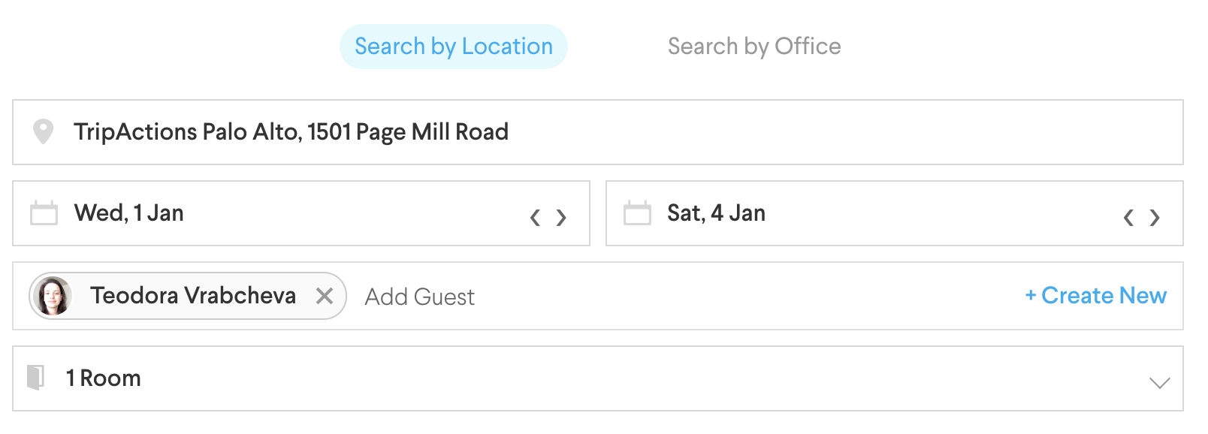

30 million records 60 independent variables Pairwise learning to ranks algorithm

Slide 10
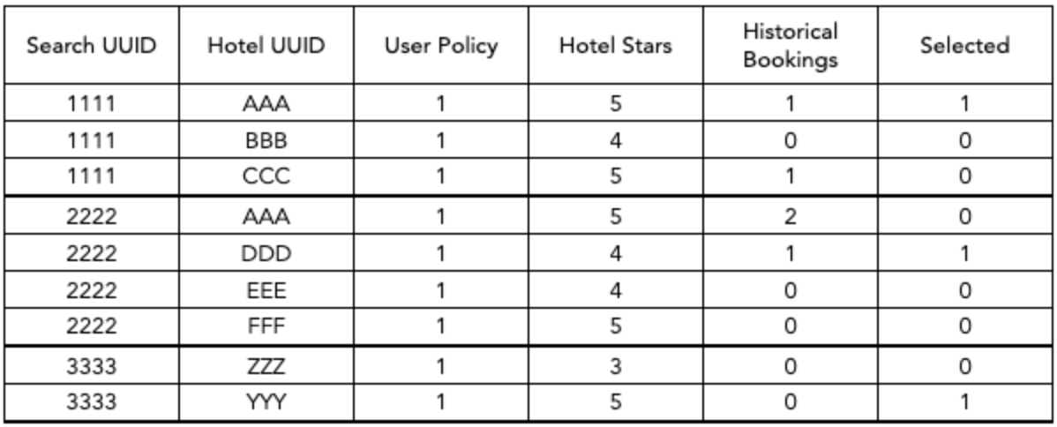
100 thousand records 10 independent variables Pointwise learning to ranks algorithm
Predict the probability of a hotel booking
Sort the hotels per search based on the predicted probability
The hotel with the highest probability will be recommended at the top
IVs
DV

Slide 11
Model specific feature importance

Slide 12
Given a tree based model provides a rank of the features
Impurity
Feature weights
Coverage
Notes:
Feature importance derived at model level (applicable for tree-based models) – given a specific model provides a rank of the features explaining the target variable
Impurity: decrease in node impurity weighted by the probability of reaching that node
Feature weights: number of times a feature appears in a tree across the ensemble of trees
Coverage: average coverage (number of samples affected) of splits which use the feature

Slide 13
The impurity method explained
Decrease in node impurity weighted by the probability of reaching that node
Decrease in node impurity: I=G_{parent}−P_{split1}G_{split1}−P_{split2}G_{split2}
Weighted feature importance:
Distance: (100/100) * 0.23 = 0.23
User bookings: (65/100) * 0.08 + (60/100) * 0.009 = 0.057
Notes:
Feature importance derived at model level (applicable for tree-based models) – given a specific model provides a rank of the features explaining the target variable
Impurity: decrease in node impurity weighted by the probability of reaching that node
Feature weights: number of times a feature appears in a tree across the ensemble of trees
Coverage: average coverage (number of samples affected) of splits which use the feature

Slide 14
The impurity method is biased towards continuous variables
Each time a break point is selected in a variable, every level of the variable is tested to find the best break point
Continuous or high cardinality variables will have many more split points, which results in the “multiple testing” problem
Notes:
The gain method that is most commonly used tends to overinflate the importance of continuous features or categorical features with many levels. This happens because of the nature of how a decision tree is being built by finding the optimal split. A continuous variable has many more options to be chosen for a split. And testing more split points means there is a higher probability of finding a split that purely by chance happens to predict the dependent variable well. There is a study in 2018 that showed how a random variable is more important than the number of bedrooms for predicting apartment prices in NY.

Slide 15
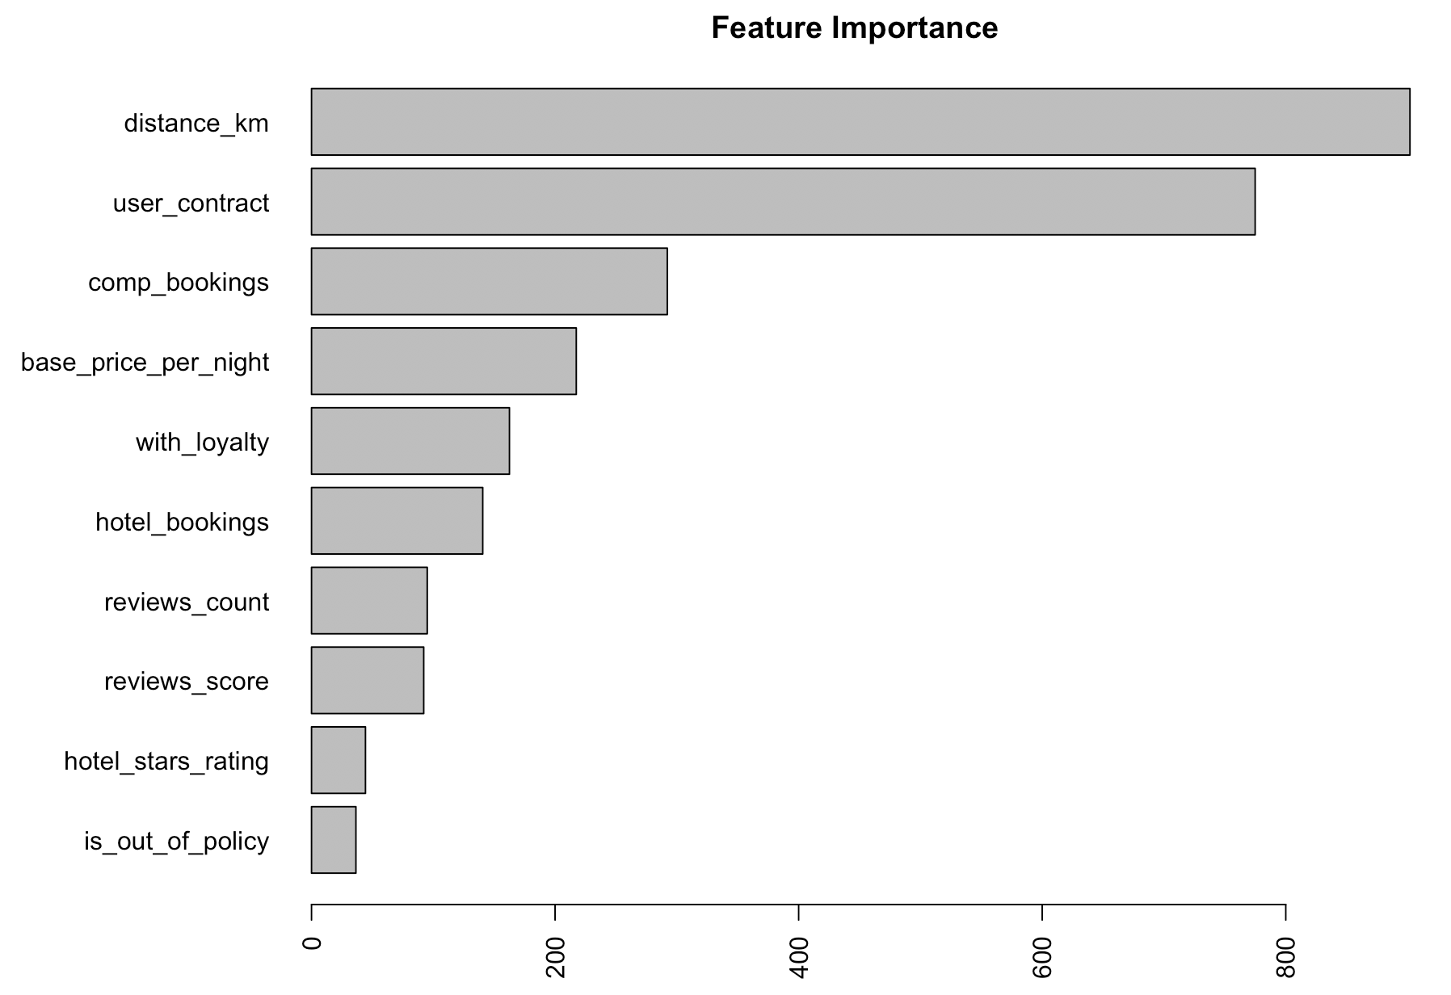
Hotel ranker impurity feature importance

Slide 16
Exercise Model specific feature importance
Create a copy of the train and the test data
Create a random uniformly distributed variable with minimum 0 and maximum 100
Retrain the same Random Forest model
Extract the variable importance and compare with the initial results
If you have time repeat with a random binary variable

Slide 17
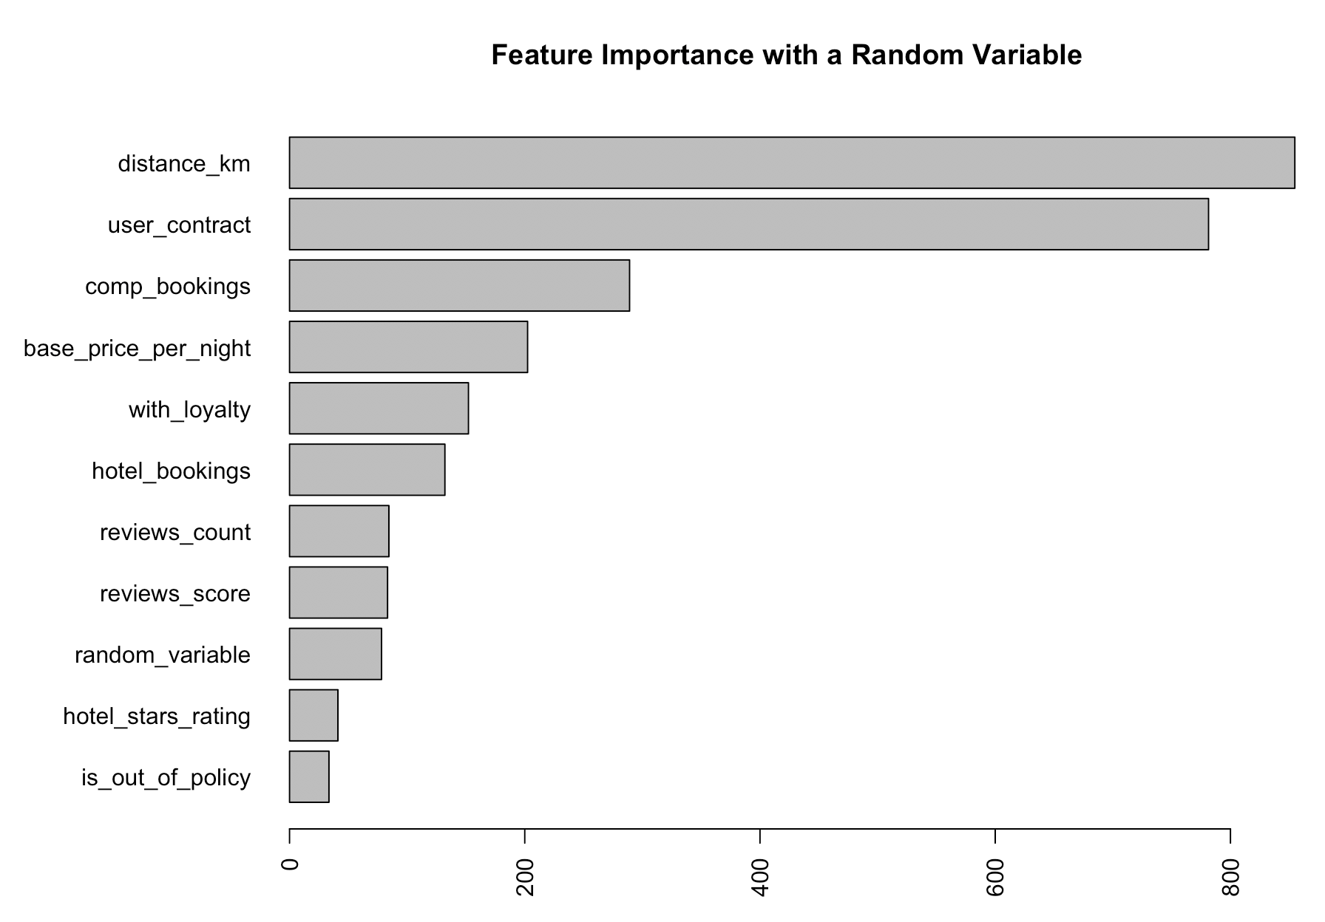
Bias towards continuous variables

Slide 18


Use with caution!
What drives the model predictions
Why did the model take a certain decision
How can we trust the model predictions
Quick and easy
Consistent
Applicable to any model
Notes:
Careful what you do, know the defaults. In python default is weights which is biased – most important feature is very descriptive used twice at the top of the tree and the rest is fine tuning
Which features are important in the decision-making process. This ensures fairness
We should be able to explain why certain features were responsible in driving certain decisions. each parameter in the system entails simple and measurable impact. Accountability
Can we prove that the model will perform and converge on unseen data. Transparency

Slide 19
Shapley Values

Slide 20
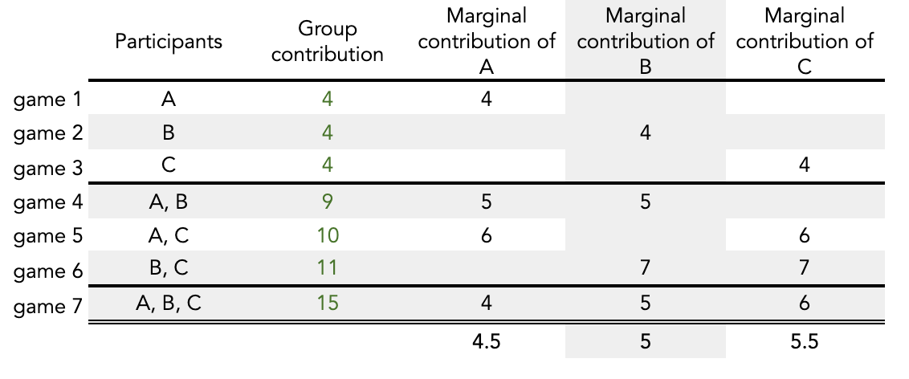
Estimate the contribution for each player / feature Shapley value regression
Imagine we have only 3 features A, B and C, to estimate their Shapley values we need to make a prediction by using all combinations of using only 1 feature, a combination of 2 or all 3 features (in total 7 predictions). For example:
The Shapley value of B is the average of its marginal contributions across all differently sized subgroups and in our example it is equal to 5 = [4(individual output) + 6(average contribution to subgroups of size two) + 5] / 3

Slide 21



Innovative method for estimating Shapley Values applied to big data
Estimate the Shapley Values for all features for all possible combinations
For a local prediction, the goal is to explain the difference between the average prediction and an individual prediction
The global feature importance is the mean absolute value of all individual Shapley Values

Slide 22
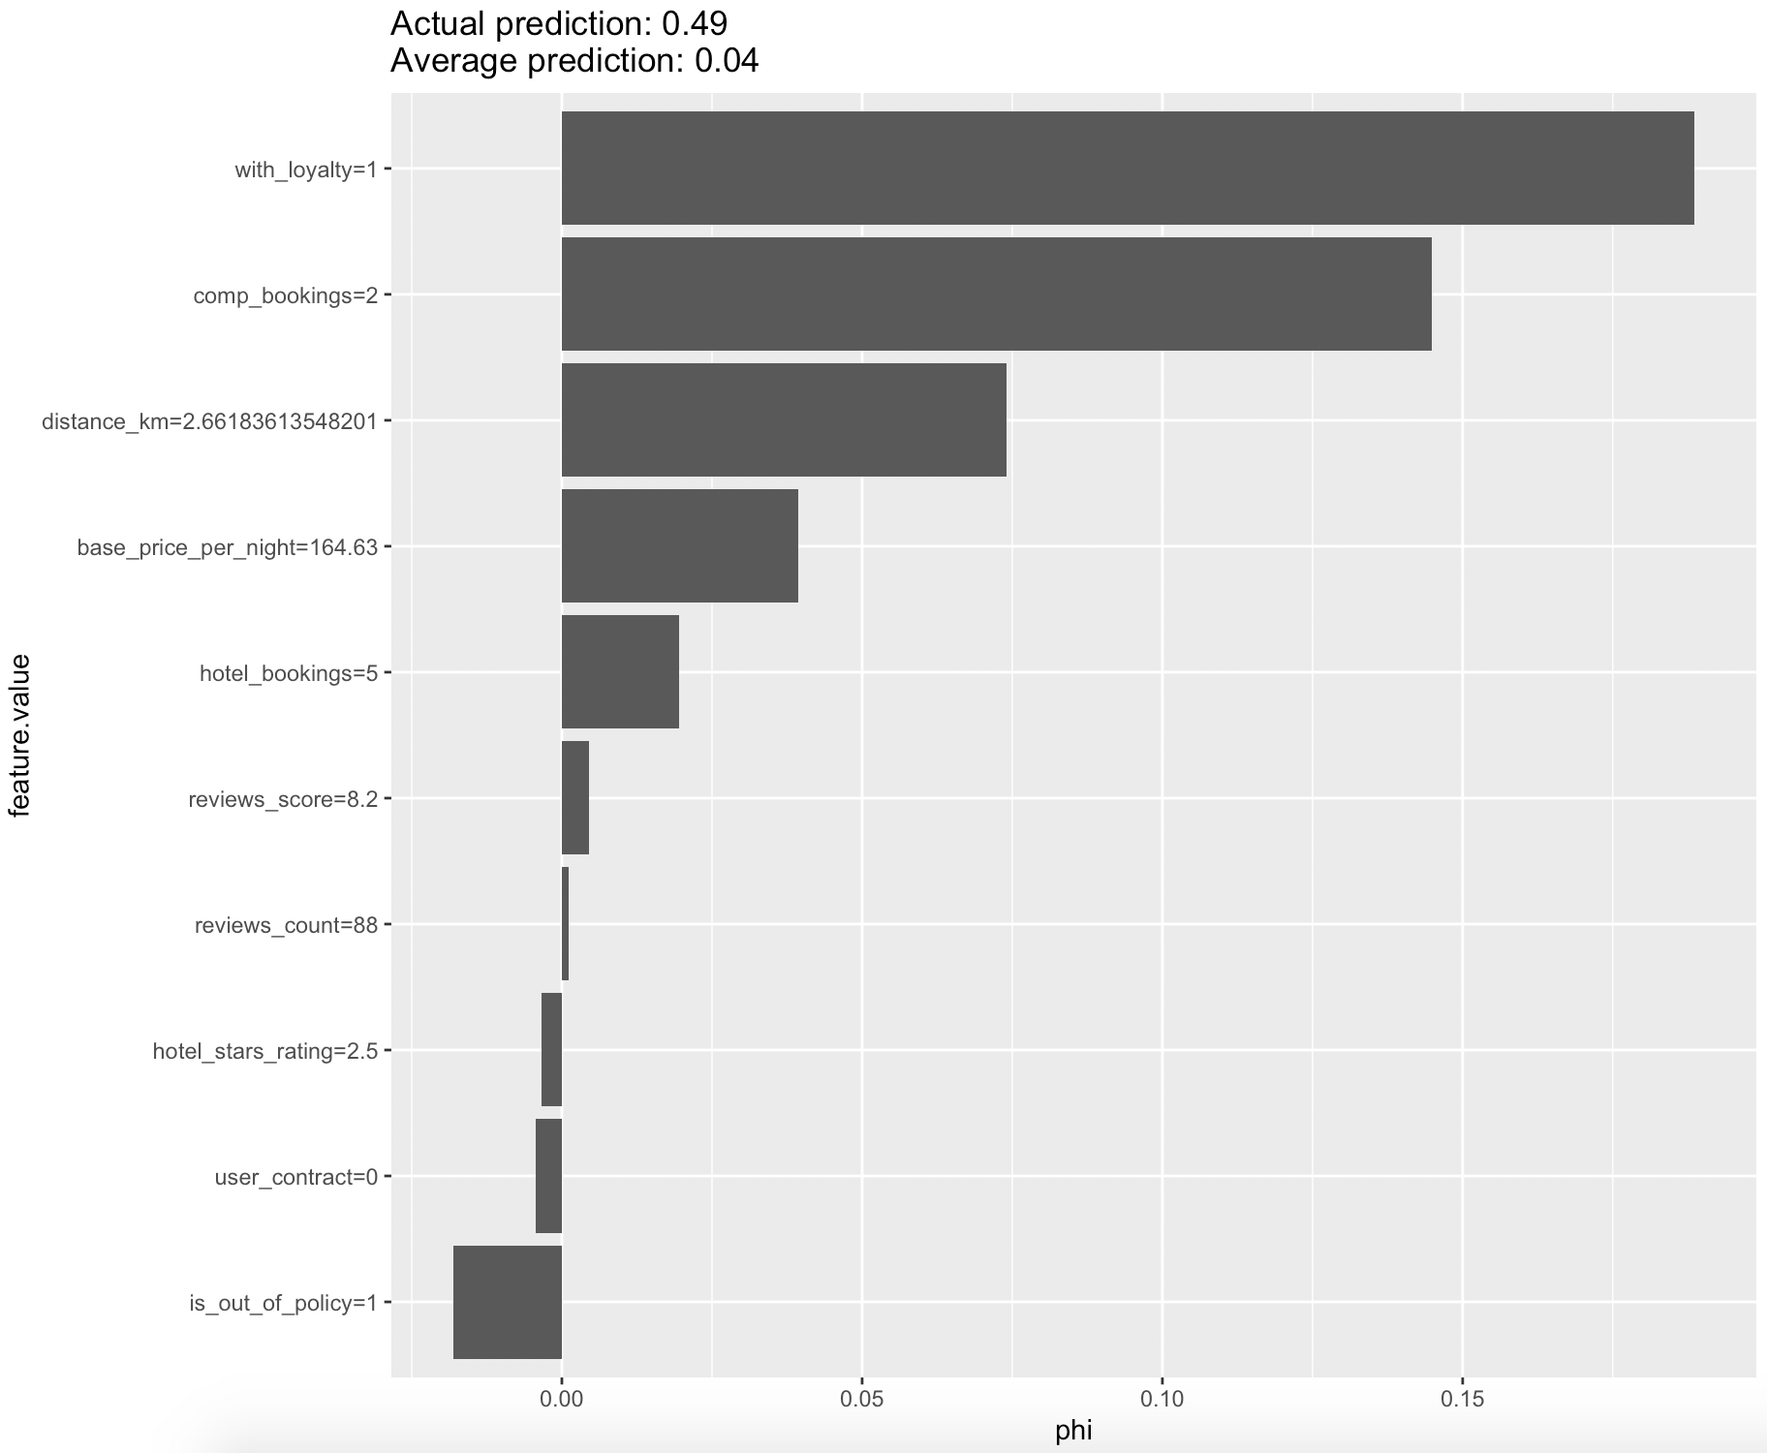
Hotel ranker Local explanation based on Shapley Values (search_uuid == “3d11ba8b-7547-4dbd-802a-6e98ddaca1cf”)
Predicted Hotel

Slide 23

Recommendations for similar users are based on the same features
Tedy
Karo

Slide 24
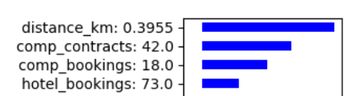
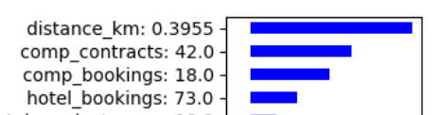
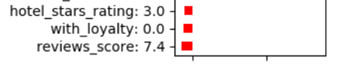
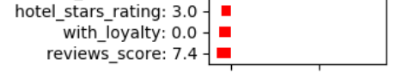
Predictions for similar users are based on the same features
Tedy
Karo

Slide 25

Different features matter for different users

Slide 26
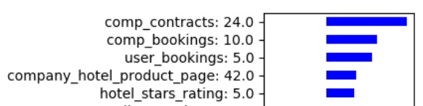
Different features matter for different users
Tedy
Ariel

Slide 27
Exercise Shapley Values
Look at a few searches for which the top predicted hotel was not booked
Chose a search for which the top predicted hotel was not booked. I suggest choosing a search that has relatively high predicted probability of the top recommended hotel (mispredicted_hotels, set the correctly_predicted=“no”)
Create a subset dataframe that contains only this search
Extract the top recommended hotel for this search (the_recommended_one)
Look at the Shapley Values for the top recommended hotel
Extract the booked hotel for this search (the_booked_one)
Look at the Shapley Values for the booked hotel
Compare the Shapley Values of the booked hotel and the recommended one, what recommendations would you make if you are to improve the model performance

Slide 28
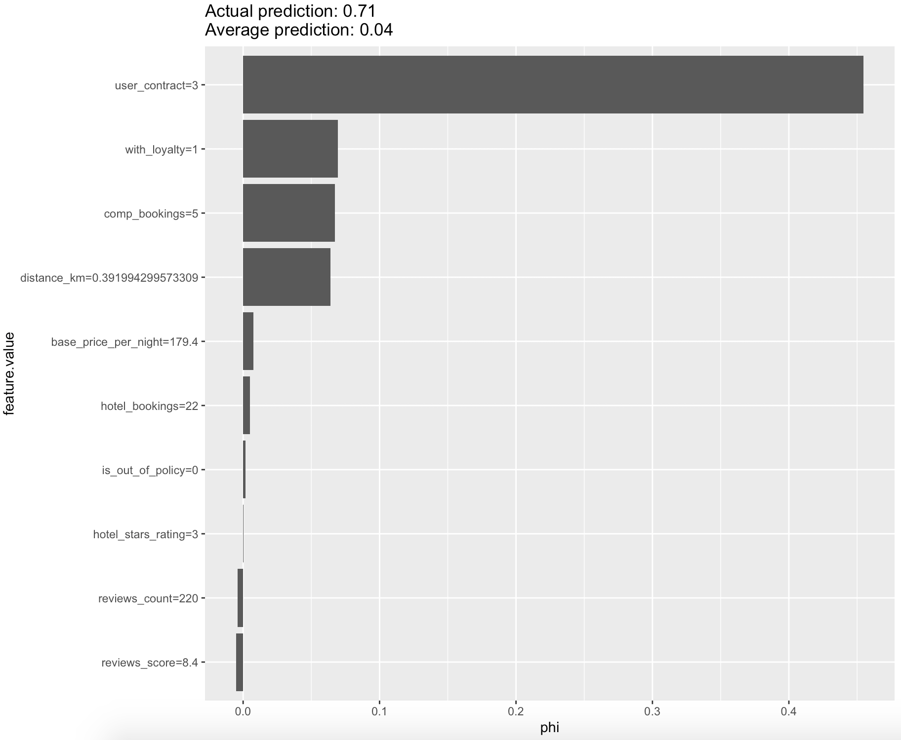
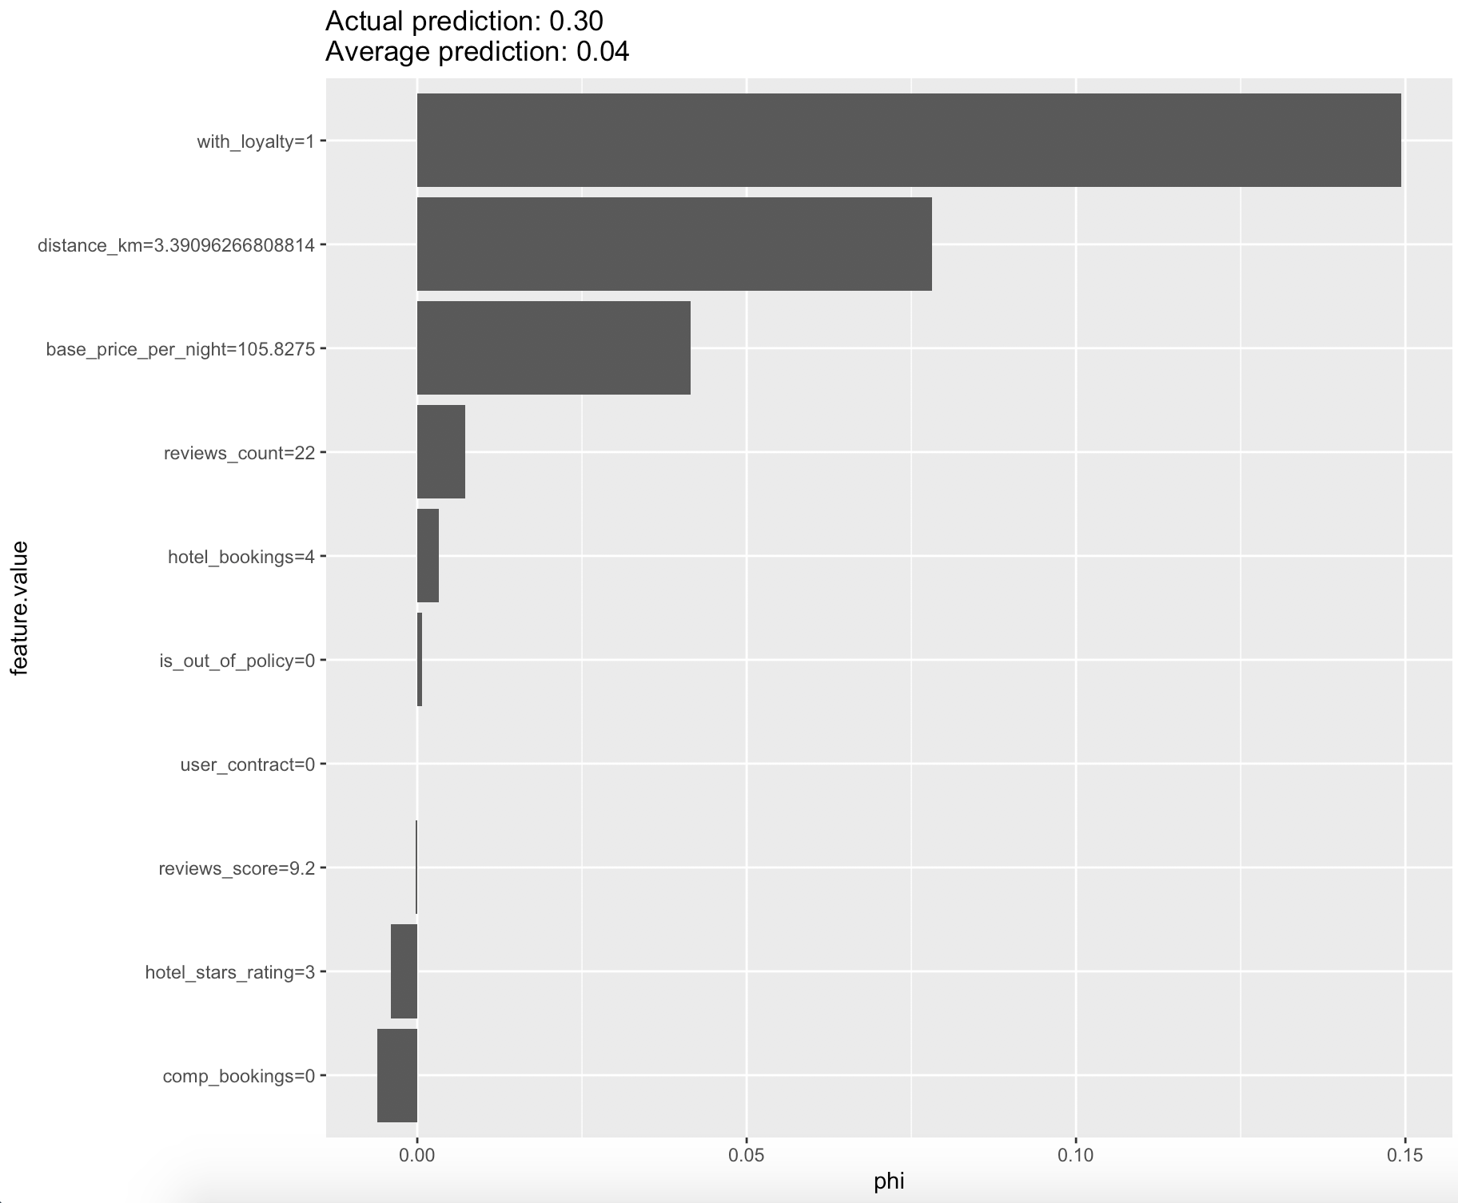
The model fails to predict hotels with which the user hasn’t interacted (search_uuid == “c1657667-466b-4b1c-a627-aec3fe1fb7d8”)
Predicted Hotel
Booked Hotel

Slide 29
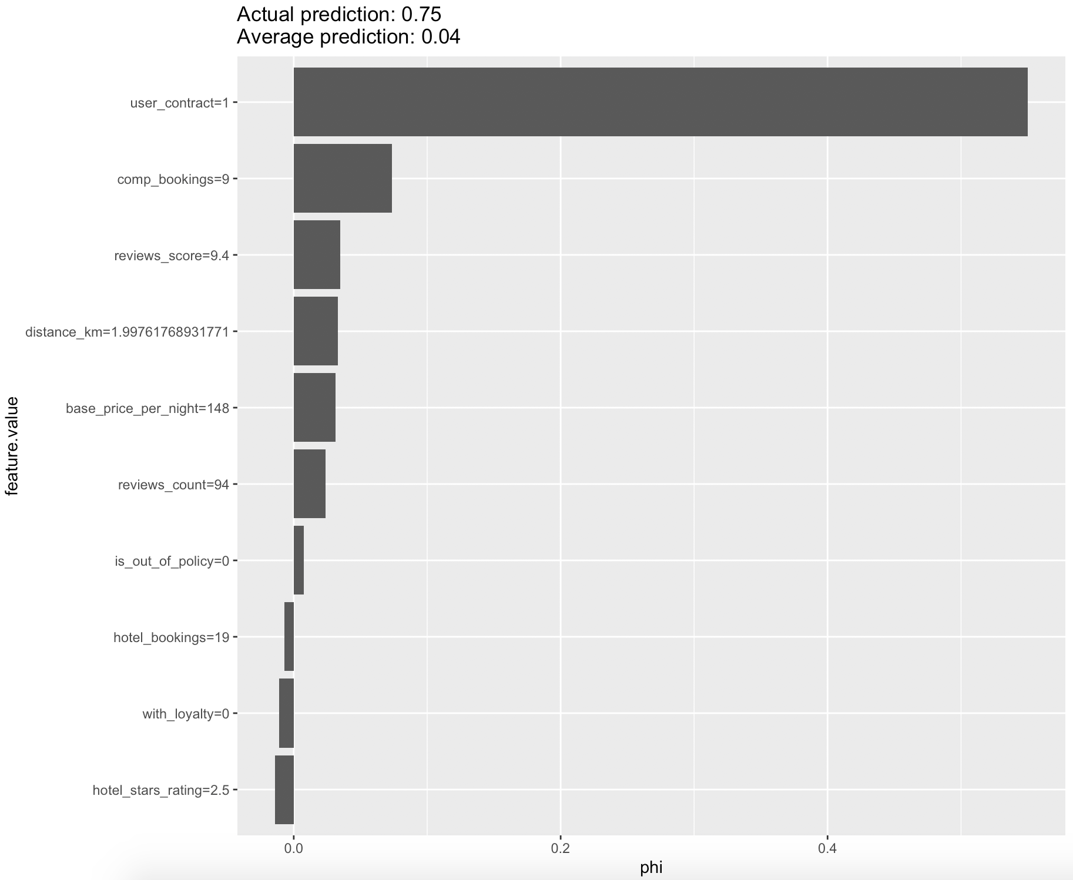
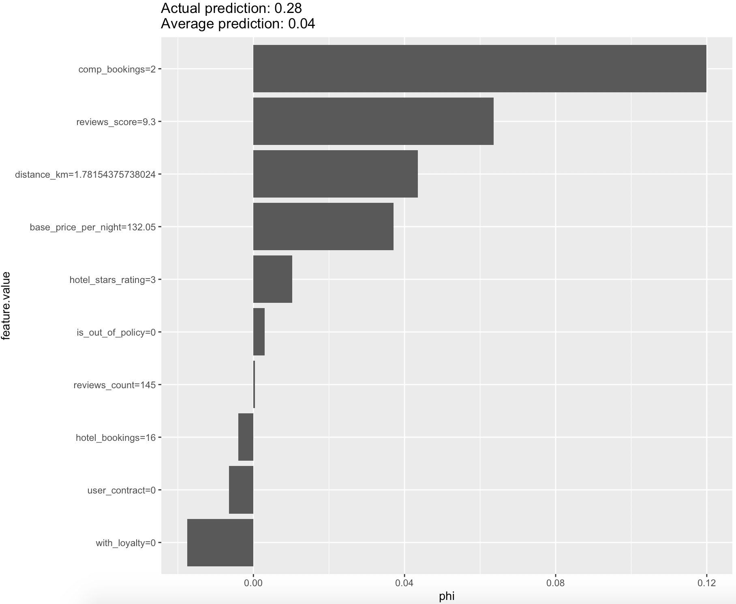
The model fails to predict hotels with which the user hasn’t interacted (search_uuid == “90851c82-fb74-4f91-9542-8757e2ff68aa”)
Predicted Hotel
Booked Hotel

Slide 30
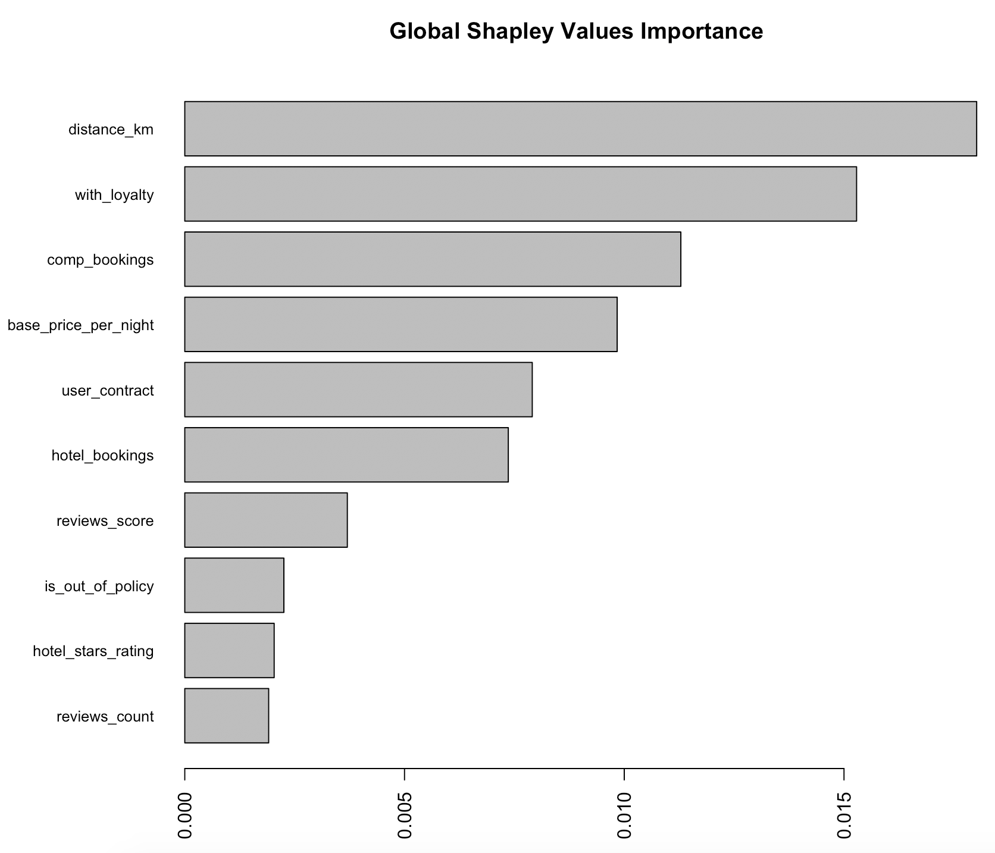
At global level having a loyalty is very important

Slide 31
Interpret with caution!
What drives the model predictions
Why did the model take a certain decision
How can we trust the model predictions
Quick and easy
Consistent
Applicable to any model

Slide 32
Surrogate Models

Slide 33




Solving machine learning interpretability by using more machine learning Global surrogate model
Train a black box model
Train the interpretable model (surrogate) on the predictions of the black box model
Measure how well the surrogate model replicates the prediction of the black box model
Interpret the surrogate model
Notes:
A global surrogate model is an interpretable model that is trained to approximate the predictions of a black box model. We can draw conclusions about the black box model by interpreting the surrogate model. Solving machine learning interpretability by using more machine learning!
Train a black box model
Choose an interpretable white box model (surrogate)
Train the interpretable model on the original dataset and its predictions
Measure how well the surrogate model replicates the prediction of the black box model
Interpret the surrogate model

Slide 34
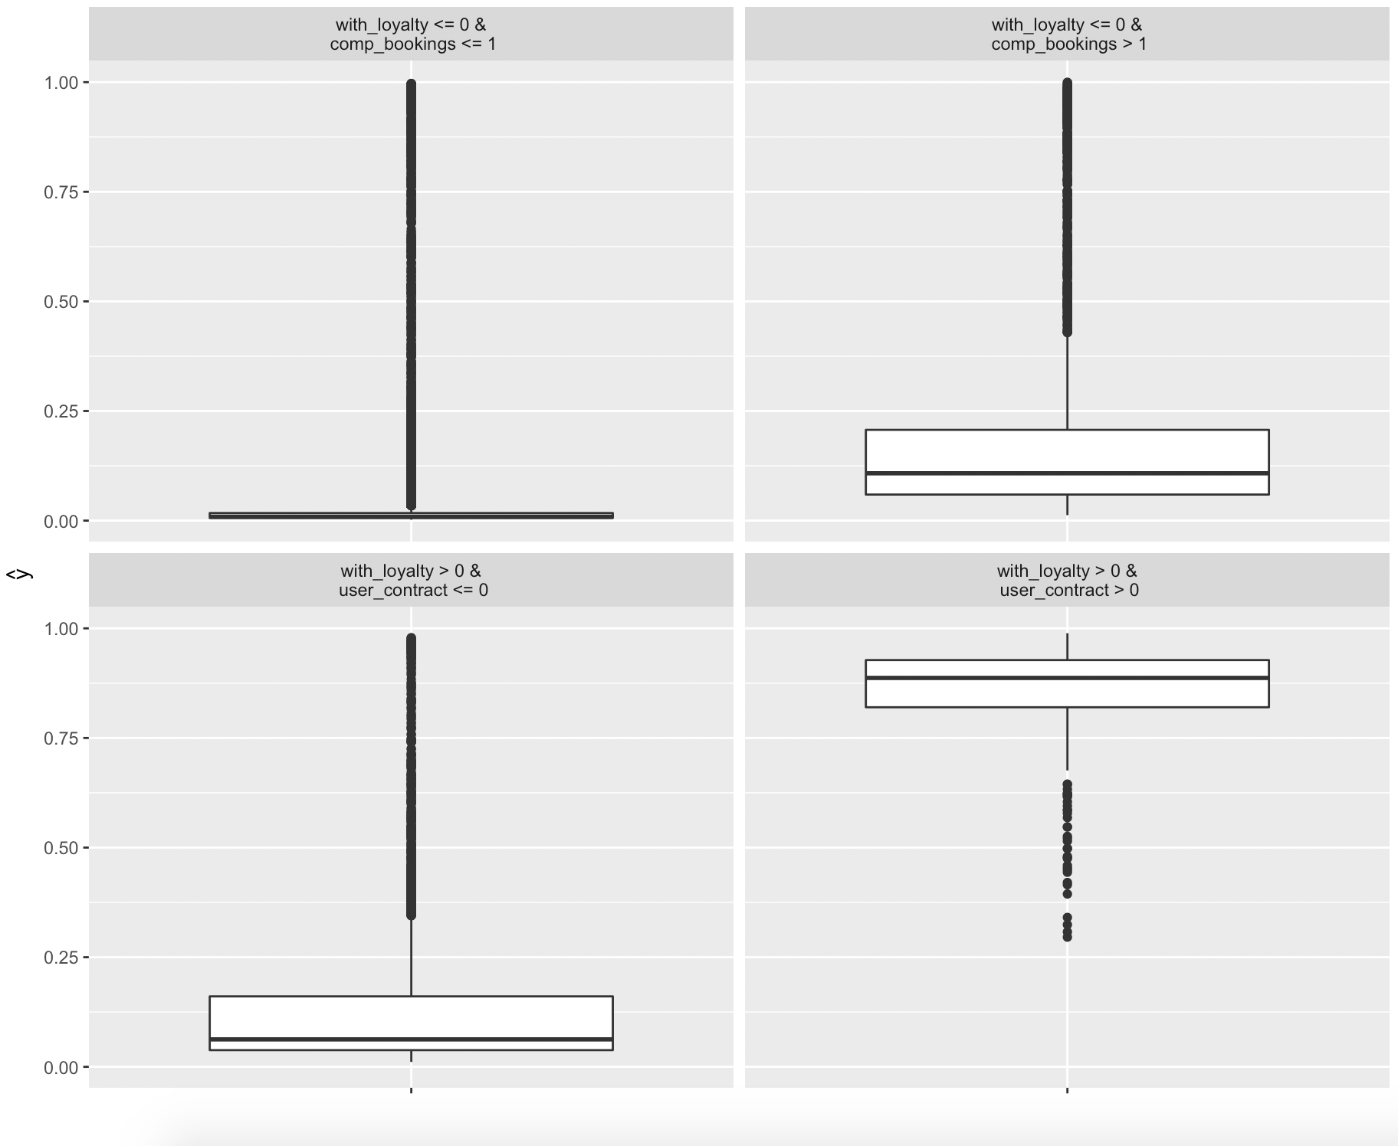
A decision tree with depth 2 fails to approximate the random forest model
Decision Tree for
Approximating Random Forest (Rsq=0.34)

Slide 35
Based on the global surrogate method distance is not amongst the top features
Global Surrogate Model (Rsq=0.34)

Slide 36
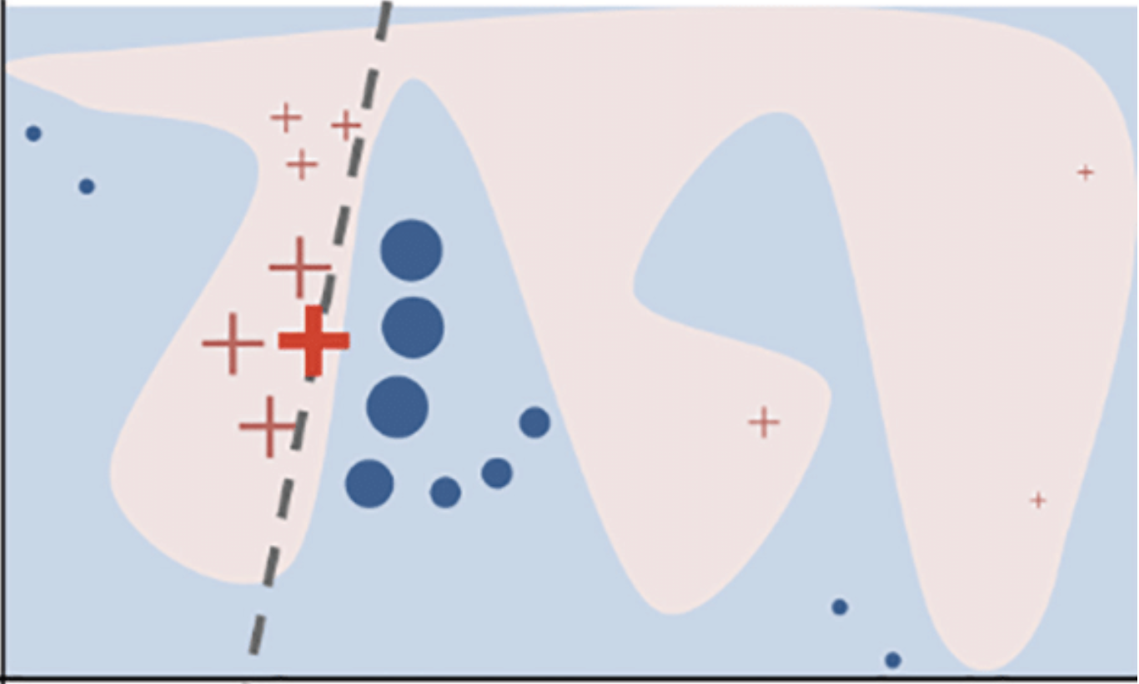
Solving machine learning interpretability by using more machine learning Local Interpretable Model-Agnostic Explanations (LIME)
Select the point which you want to understand
Get the predictions for a few other points
Weight the new samples according to their proximity to the instance of interest
Train a weighted, interpretable model on the new dataset

Slide 37
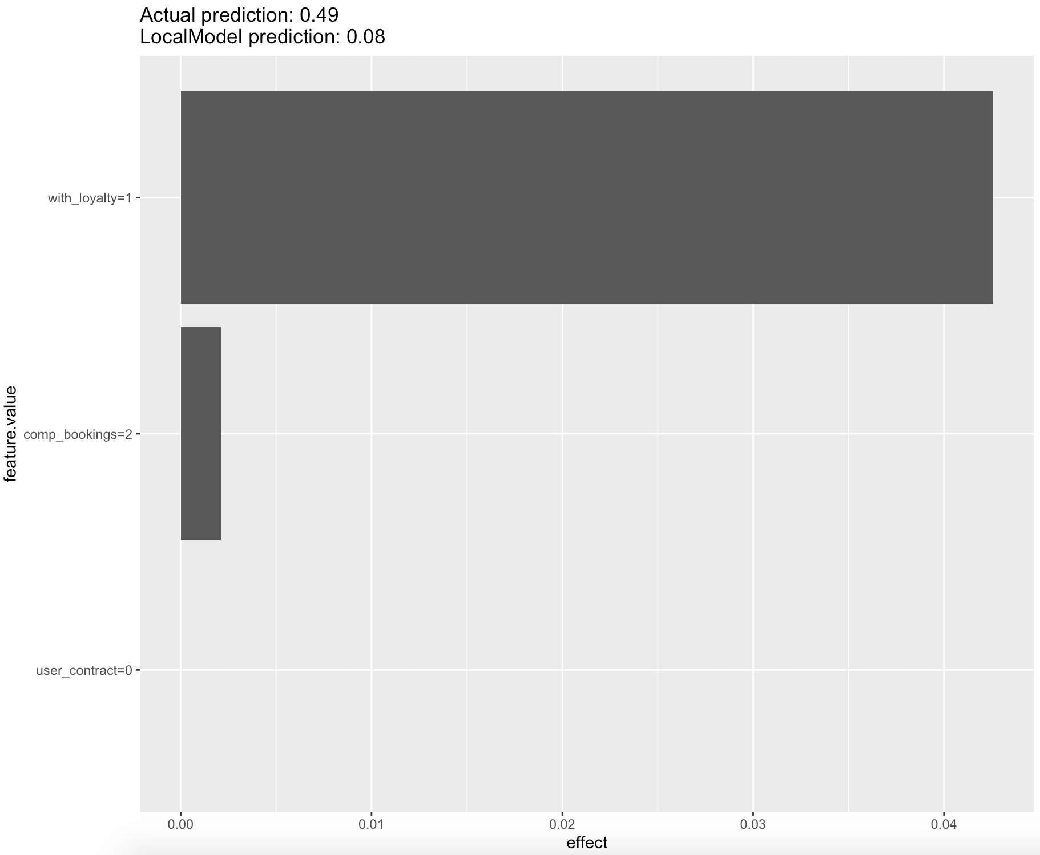
The top two features are the same based on the LIME and the Shapley Values methods (search_uuid == “3d11ba8b-7547-4dbd-802a-6e98ddaca1cf”)
LIME Explanation
Shapley Values Explanation

Slide 38
Exercise LIME
Compare LIME explanations with local Shapley Values
Extract the LIME explanation for one of the mispredicted hotels for which you looked at the local Shapley Values
Plot the LIME and the Shapley next to each other and discuss the differences
Extract the LIME explanation for the actually booked hotels for which you looked at the local Shapley Values
Plot the LIME and the Shapley next to each other and discuss the differences

Slide 39
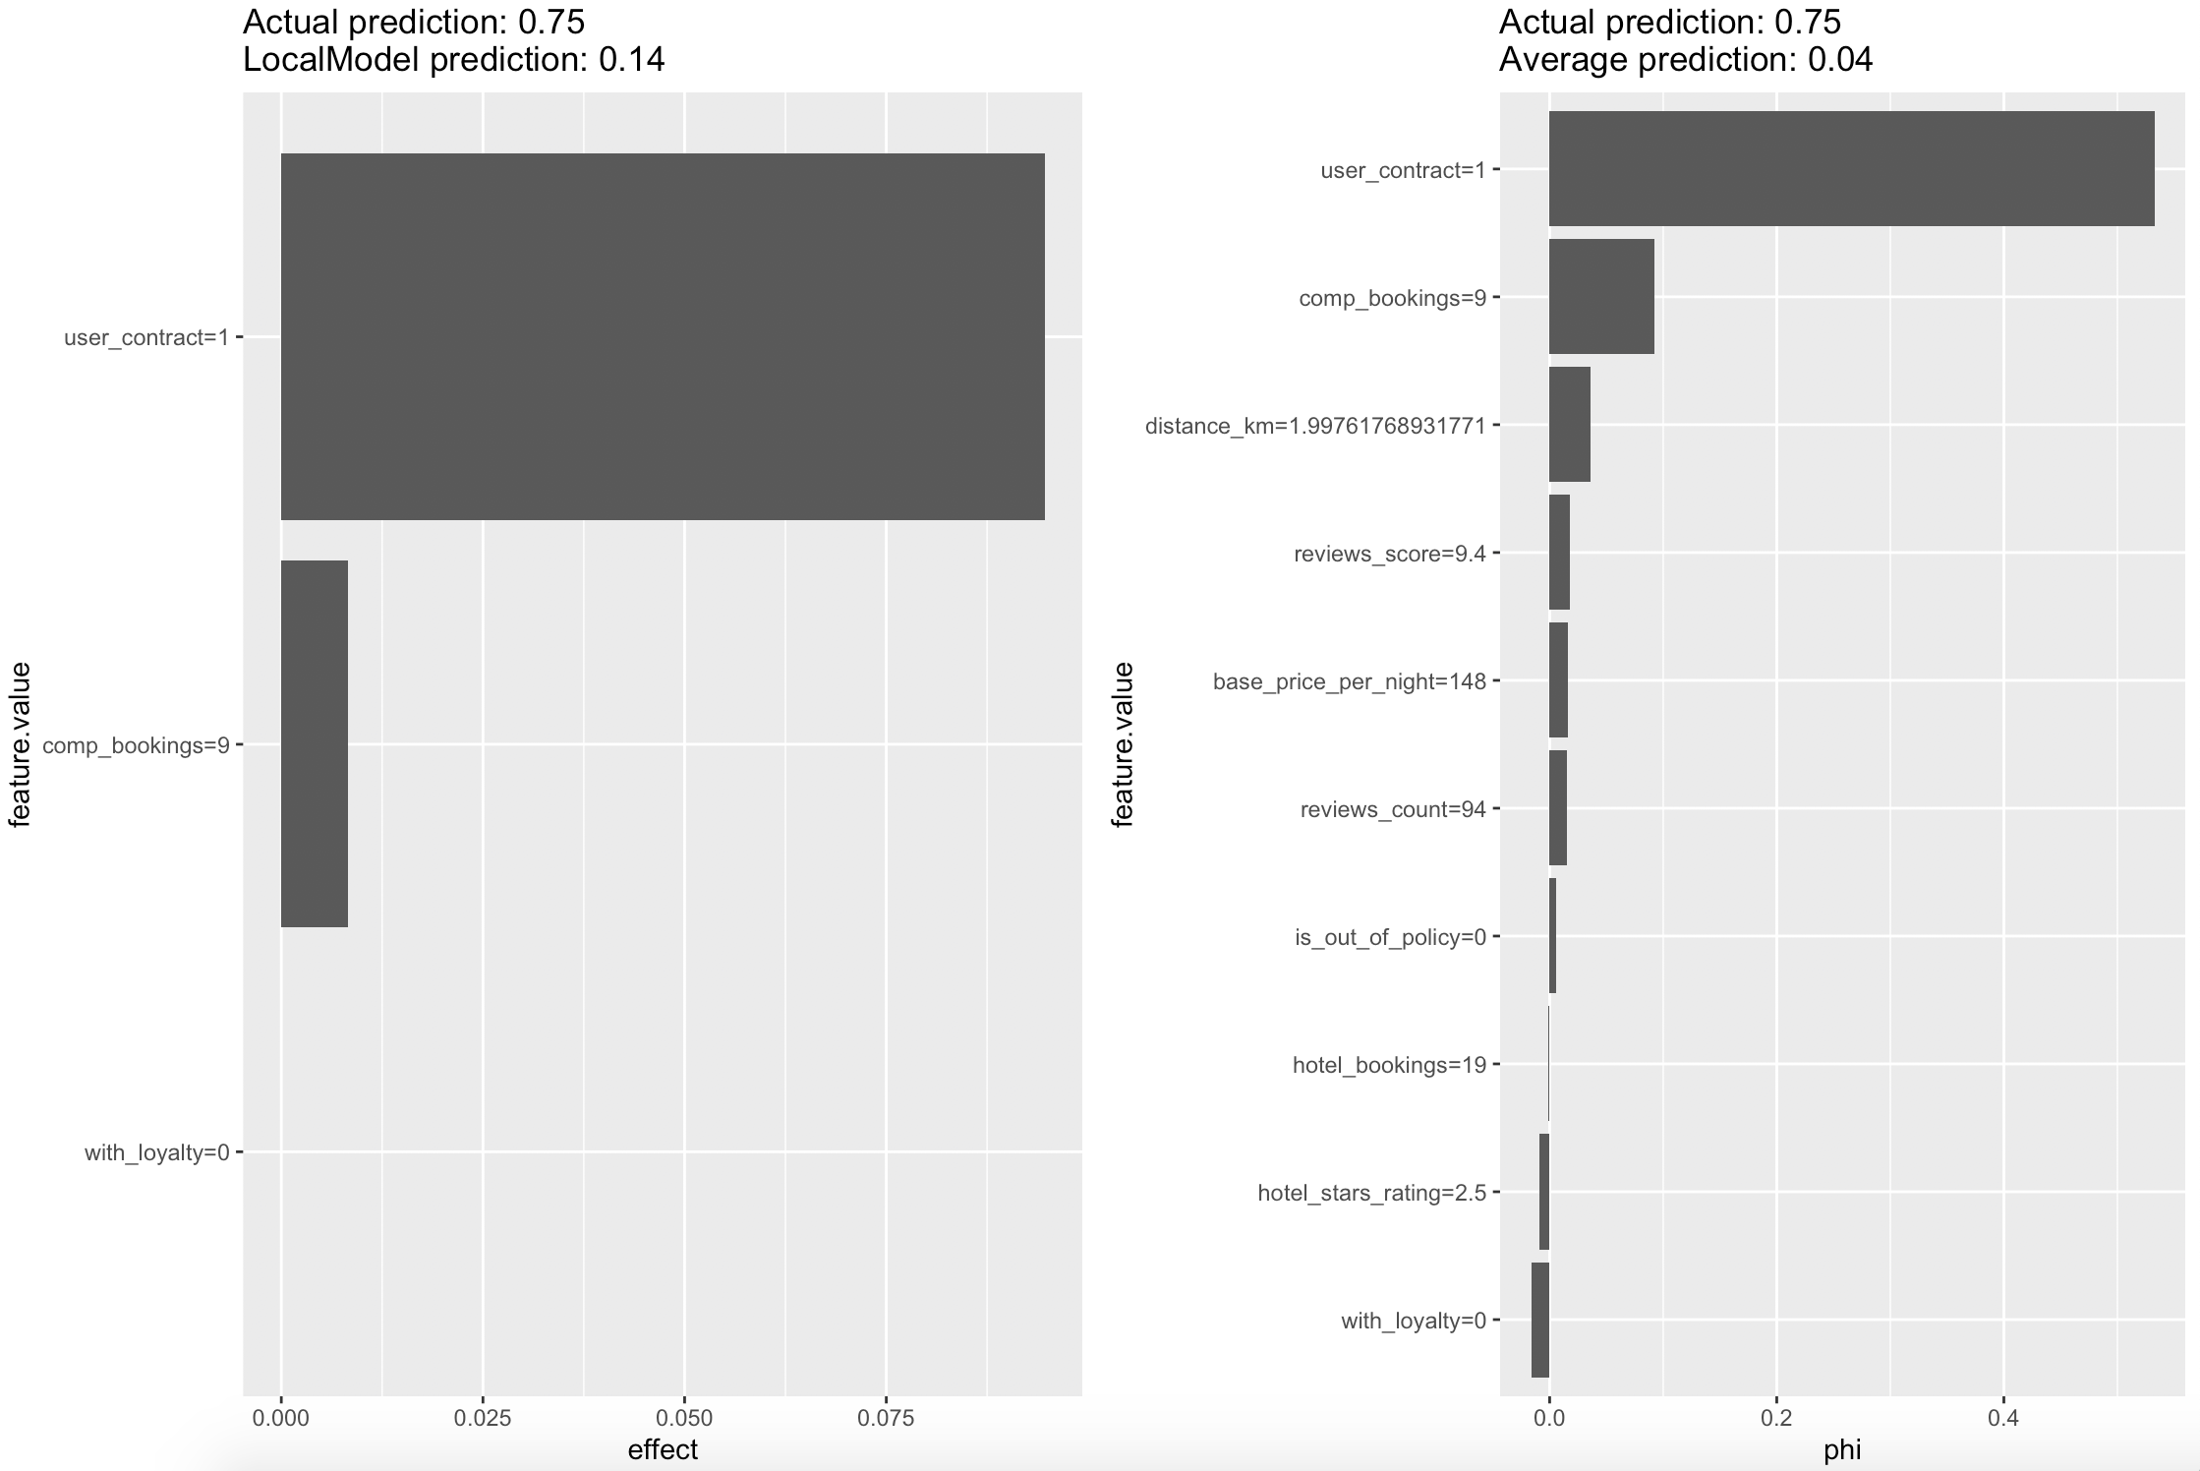
The LIME and the Shapley Value methods are inline for the hotel we have predicted at the top (search_uuid == “90851c82-fb74-4f91-9542-8757e2ff68aa”)
LIME Explanation
Shapley Values Explanation

Slide 40
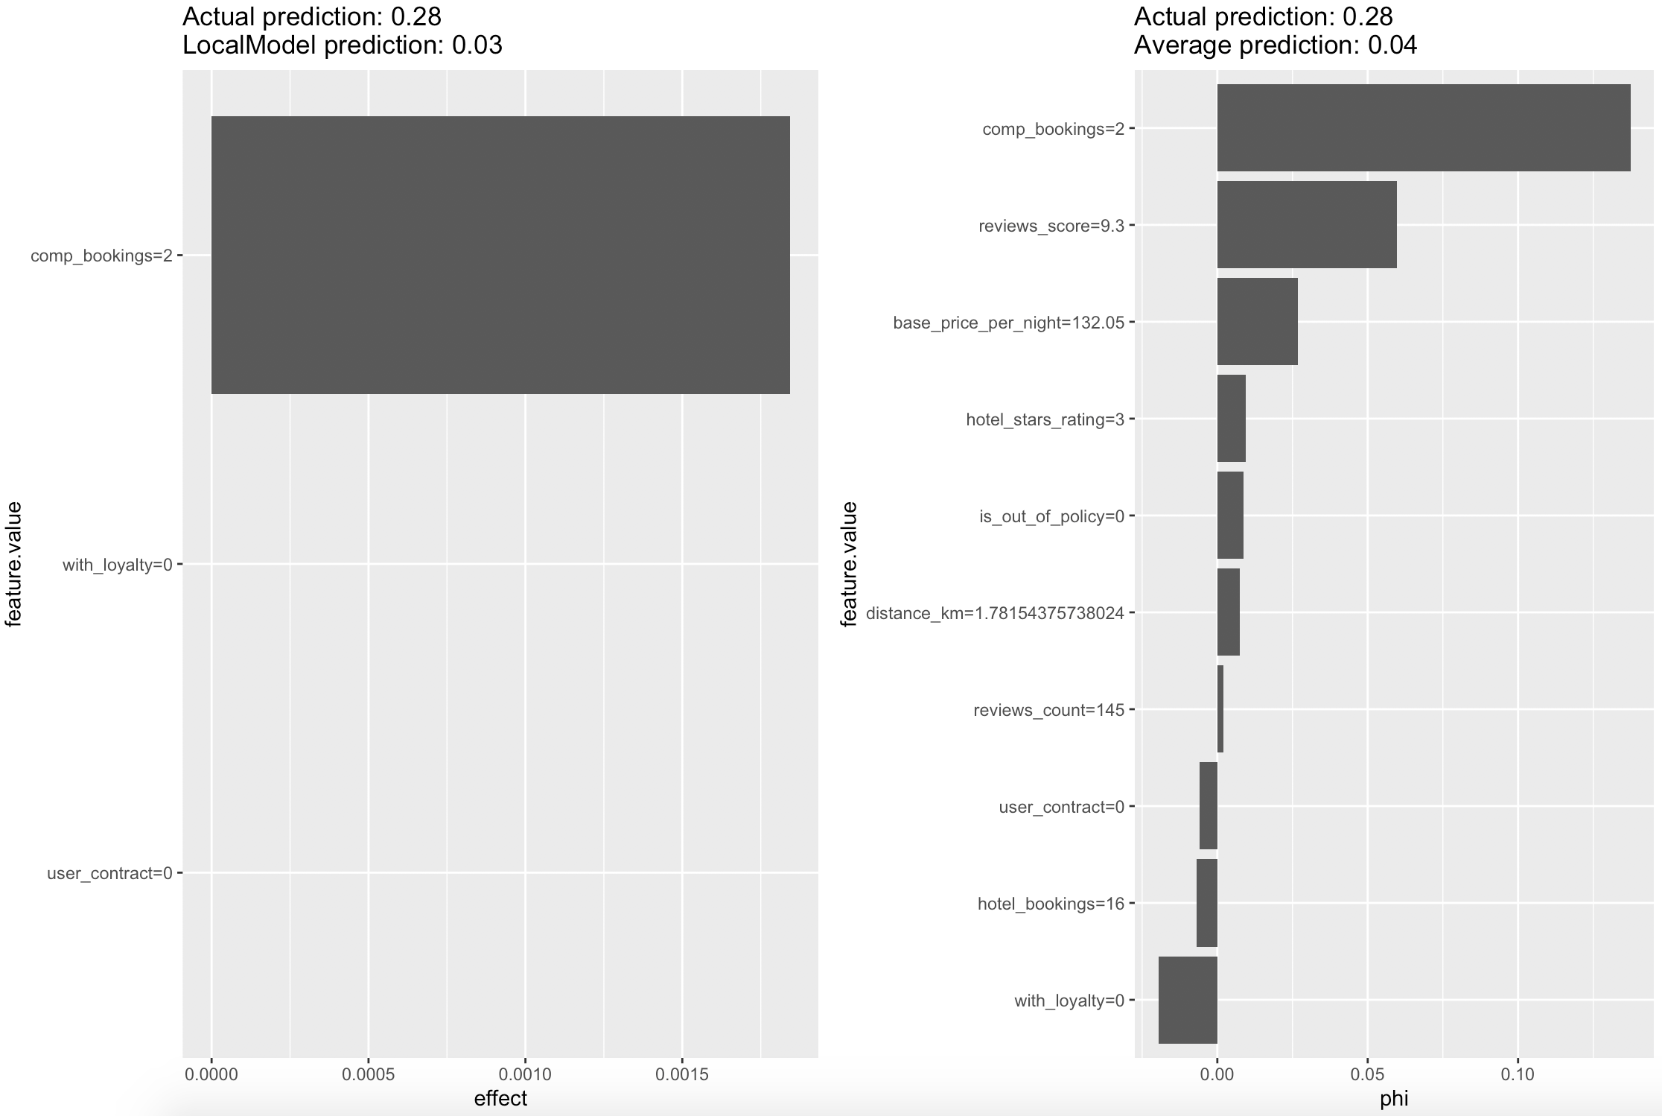
The LIME and the Shapley Value methods are inline for the mispredicted hotel (search_uuid == “90851c82-fb74-4f91-9542-8757e2ff68aa”)
LIME Explanation
Shapley Values Explanation

Slide 41
Spend the time to fine tune the surrogate model
What drives the model predictions
Why did the model take a certain decision
How can we trust the model predictions
Quick and easy
Consistent
Applicable to any model

Slide 42
Summary

Slide 43
How to pick an interpretability tool?
Do you need to understand the whole logic of a model, or do you only care about the reasons for a specific decision?
What’s your time limitation?
What is the user’s expertise level?
What’s your model’s independent variables complexity?
Depends

Slide 44
Sources
Interpretable Machine Learning (Christoph Molnar 19)
“Why Should I Trust You” Explaining the Predictions of Any Classifier (M. T. Ribeiro 2016)
tvrabcheva@tripactions.com

Slide 45
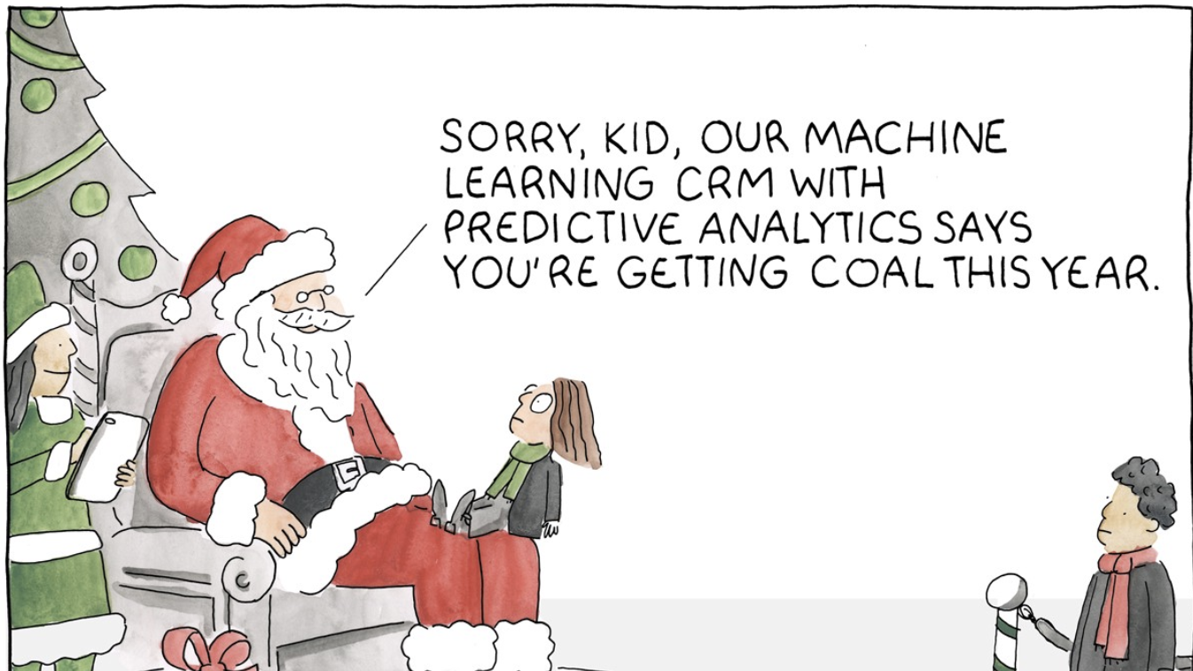

Slide 46
Appendix

Slide 47
Permutation importance

Slide 48
Permutation feature importance
Measures feature importance by observing how random re-shuffling of each IV influences model performance. A feature is “unimportant” if permuting its values keeps the model error unchanged
Train the model and note performance
Reshuffle the values from one of the features at random
Retrain the model and note the performance
The difference in performance between steps 1 and 3 represents the importance for this feature
Repeat for all features in the dataset K times

Slide 49
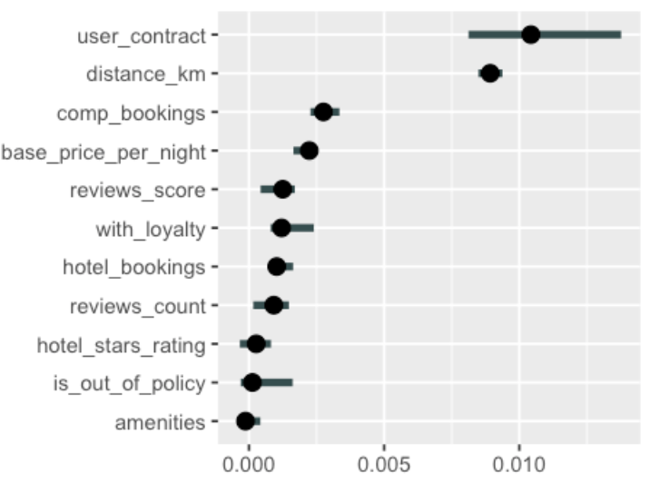
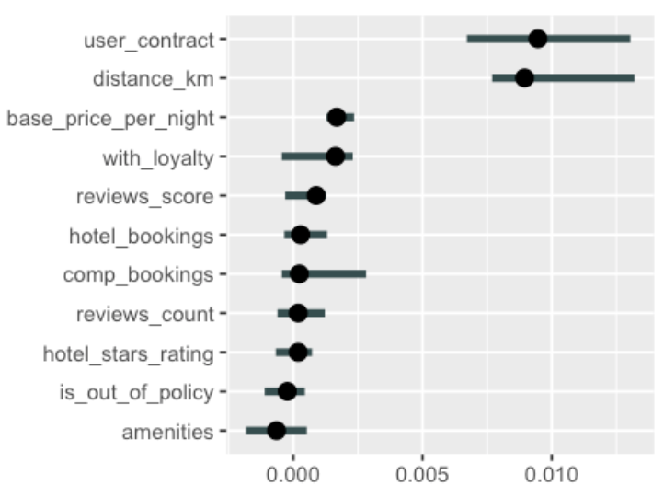
Use permutation feature importance on test data
Train data
Test data

Slide 50
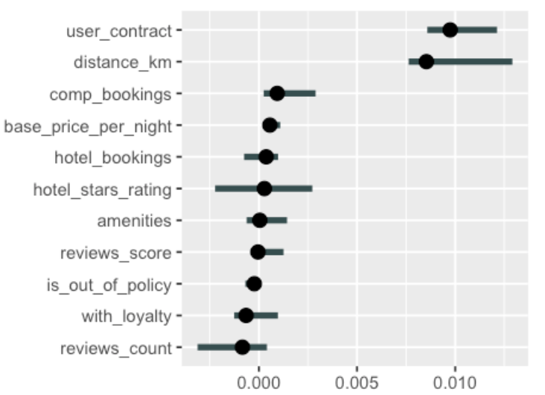
Rerun multiple times to ensure consistency
Test data
Test data rerun

Slide 51
Be prepared to wait
What drives the model predictions
Why did the model take a certain decision
How can we trust the model predictions
Quick and easy
Consistent
Applicable to any model

Slide 52
Interpretable models

Slide 53
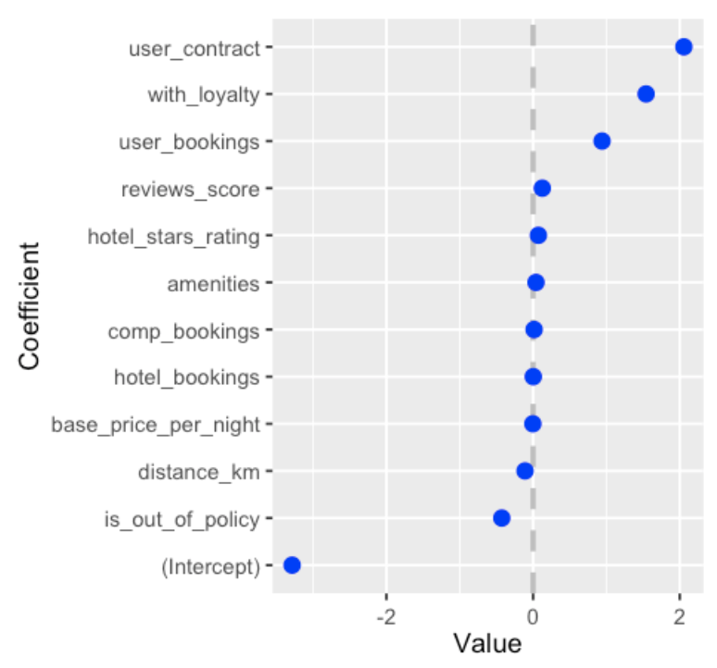
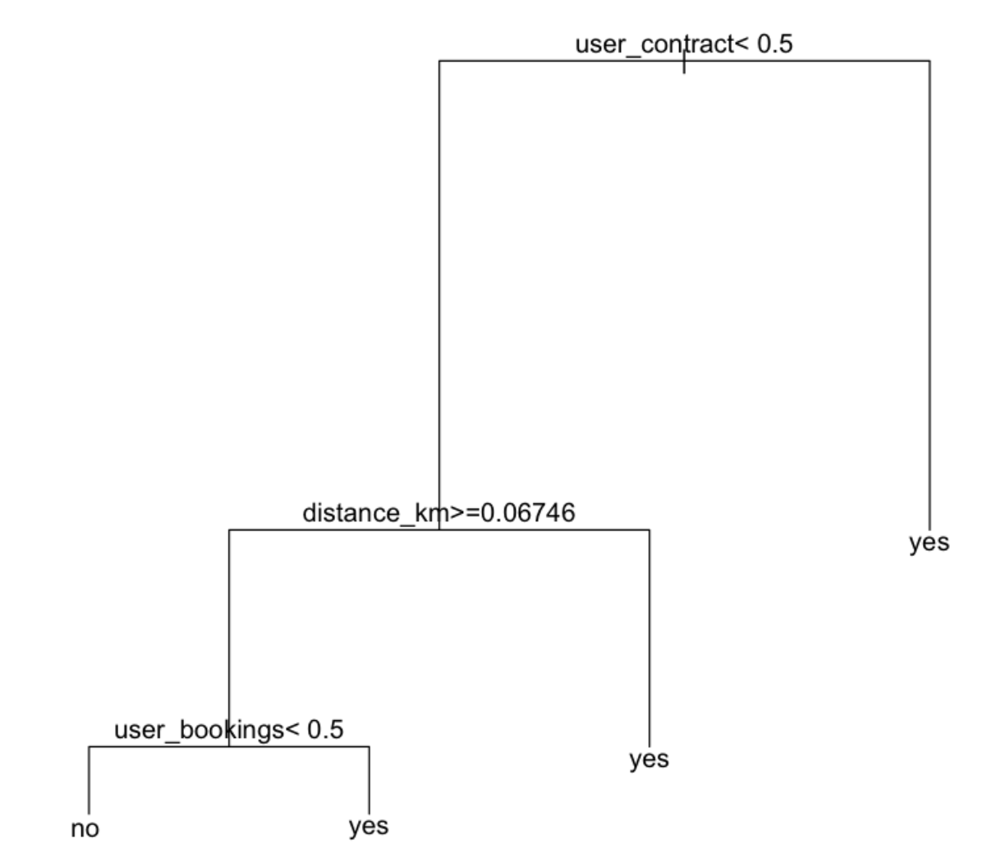
The simplest model is the best model
Logistic Regression
Decision Tree

